Slide 1


Python Programming
RGM College of Engineering & Technology (Autonomous)
Department of Computer Science & Engineering
Academic Year : 2020-2021

Slide 2
Python Language Fundamentals - 4

Slide 3

Guido Van Rossum

Slide 4
Learning Mantra
If you really strong in the basics, then remaining things will become so easy.

Slide 5
Agenda:
1. Python Identifiers
2. Reserved words (or) Keywords in Python
3. Data types in Python - Introduction

Slide 6
Python Identifiers
What is an Identifier?
A name in Python program is called identifier. It can be class name or function name or module name or variable name.
Eg: a = 20
It is a valid Python statement. Here 'a' is an identifier.

Slide 7
Python Identifiers
Rules to define identifiers in Python:
1. The only allowed characters in Python are
alphabet symbols(either lower case or upper case)
digits(0 to 9)
underscore symbol(_)
2. Identifier should not starts with digit.
3. Identifiers are case sensitive. Of course Python language itself is case sensitive language.
4. There is no length limit for Python identifiers. But not recommended to use too lengthy identifiers.
5. We cannot use reserved words as identifiers.

Slide 8
Reserved words (or) Keywords in Python
In Python some words are reserved to represent some meaning or functionality. Such type of words are called Reserved words or Keywords.
There are 33 reserved words available in Python.
True,False,None
and, or ,not,is
if,elif,else
while,for,break,continue,return,in,yield
try,except,finally,raise,assert
import,from,as,class,def,pass,global,nonlocal,lambda,del,with
All 33 keywords contains only alphabets symbols.
Except the following 3 reserved words, all contain only lower case alphabet symbols.
True
False
None

Slide 9
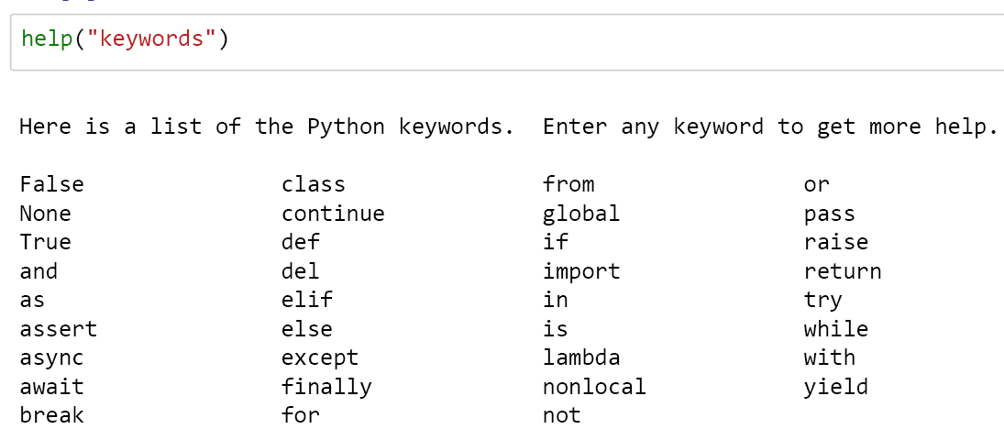
Reserved words (or) Keywords in Python 35 Keywords are available in python 3.7 In jupyter notebook keywords are highlighted with Green colour.

Slide 10
Key Points:
switch concept is not there in Python.
Similarly do while loop is not there in Python.
'int','float','char' and 'double' such type of words are not reserved words in python, because Python is Dynamically typed language.
Note : Learning Python language itself learning of all the keywords of Python.

Slide 11
Data types in Python - Introduction
Data Type represent the type of data present inside a variable.
In Python we are not required to specify the type explicitly. Based on value provided, the type will be assigned automatically. Hence Python is Dynamically Typed Language.
Among the following two statements, which are correct statements?
1. In Python, 'type' concept is not applicable.
2. In Python, 'type' concept is available, but we are not require to declare explicitly.

Slide 12
Data types in Python - Introduction
Statement 2 only correct.

Slide 13
Python contains the following in-built data types
1. int
2. float
3. complex
4. bool
5. str
6. bytes
7. bytearray
8. range
9. list
10. tuple
11. set
12. frozenset
13. dict
14. None
Almost about 14 data types we need to discuss in detail.

Slide 14
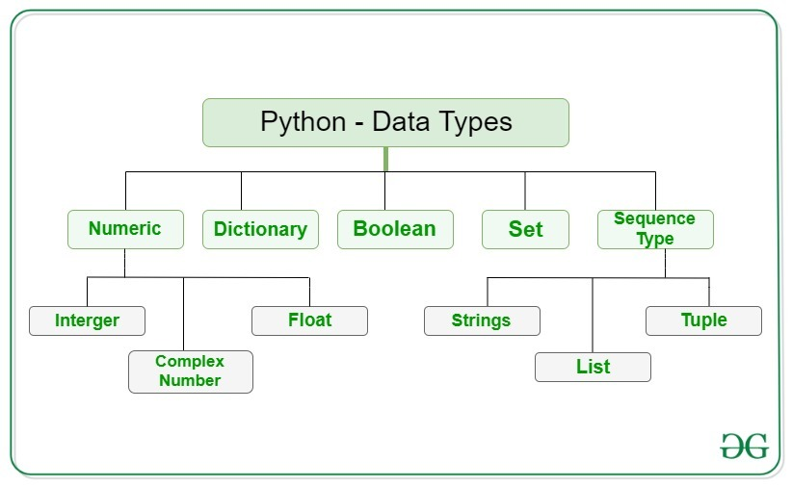
Python contains the following in-built data types

Slide 15
Before going to discuss about these data types, let us know few important points now.
Note: In Python, every thing is an Object.
Let us take an example,
a = 10
In this statement 10 is an object of class 'int'.
Here,
'a' is the reference variable which is pointing to an 'int' object.
The vale representing in the 'int' object is 10.

Slide 16
How can you find the type of 'a'?
By using an in-built function type(), we can find the type of any variable.
a = 10
type(a) ➔ int
Where the object 10 is stored in the memory? (or) What is the address of the object 'a'?
By using an in-built function id(), we can find the address of an object.
a = 10
id(a) ➔ 140712714015840

Slide 17
How can you print the value of 'a'?
By using an in-built function print(), we can print the value of a variable.
a = 10
print(a) ➔10
Note: The most commonly used in-built functions in Python are as follows:
1. type()
It is to check the type of variable
2. id()
It is used to get address of object
3. print()
It is used to print the value

Slide 18
Test Your Skills
1. Is Python case sensitive when dealing with identifiers?
a) Yes b) no c) machine dependent d) None of the mentioned
2. What is the maximum possible length of an identifier?
a) 31 characters b) 63 characters c) 79 characters d) None of the mentioned
3. Which of the following is invalid?
a) _a = 1 b) _ _a = 1 c) _ _str_ _ = 1 d) none of the mentioned
4. Which of the following is an invalid variable?
a) my_string_1 b) 1st_string c) Foo d) _
5. Which of the following is not a keyword?
a) eval b) assert c) nonlocal d) pass

Slide 19
Solutions:
1 : a
Explanation: Python is Case sensitive language.
2 : d
Explanation: Identifiers can be of any length in Python.
3 : d
Explanation: All the statements will execute successfully .
4 : b
Explanation: Variable names should not start with a number.
5 : a
Explanation: eval can be used as a variable.

Slide 20
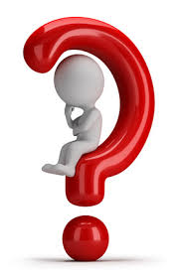
Any question?

Slide 21
If you try to practice programs yourself, then you will
learn many things automatically
Spend few minutes and then enjoy the study

Slide 22
Thank You

